Slide 1
Probability & Random Processes EE2011 Department of Electrical Engineering
NATIONAL UNIVERSITY OF COMPUTER & EMERGING SCIENCES, LAHORE CAMPUS

Slide 2



Slide 3
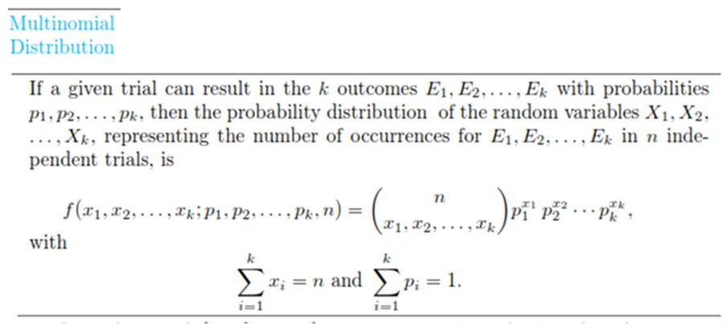

Slide 4



Slide 5
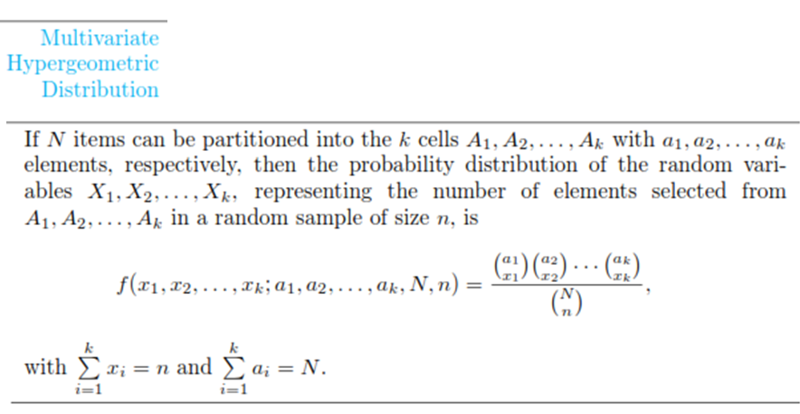

Slide 6




Slide 7



Slide 8




Slide 9




Slide 10




Slide 11




Slide 14



Slide 15




Slide 16





Slide 17
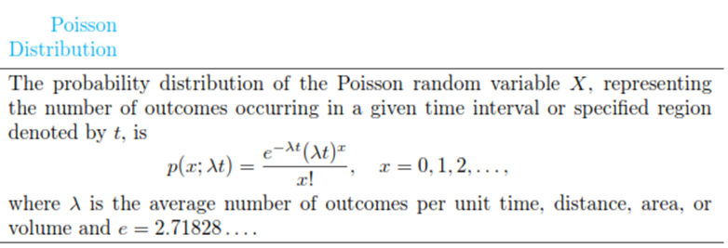


Slide 18


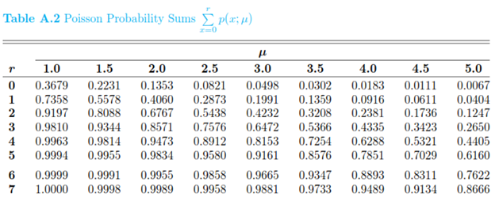

Slide 19



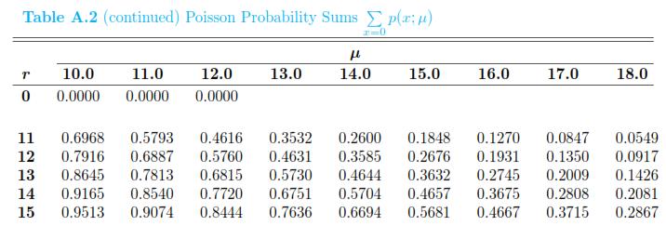

Slide 21

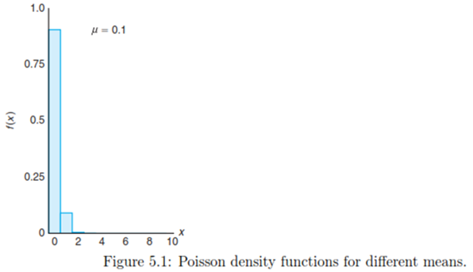
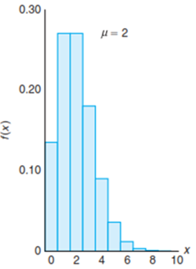
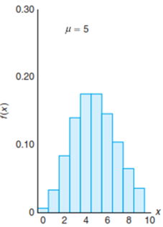

Slide 23


Slide 24


Slide 25



